Slide 1
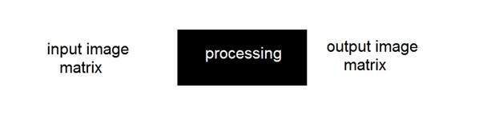
Frequency Domain
Till now, all the domains in which we have analyzed a signal , we analyze it with respect to time. But in frequency domain we don’t analyze signal with respect to time, but with respect of frequency.
In spatial domain, we deal with images as it is. The value of the pixels of the image change with respect to scene. Whereas in frequency domain, we deal with the rate at which the pixel values are changing in spatial domain.
For simplicity, Let’s put it this way.
Fig : Spatial domain

Slide 2
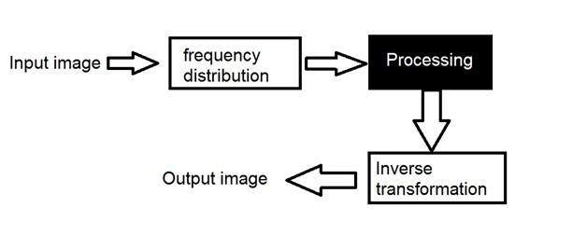
Frequency Domain
We first transform the image to its frequency distribution. Then our black box system perform what ever processing it has to performed, and the output of the black box in this case is not an image, but a transformation. After performing inverse transformation, it is converted into an image which is then viewed in spatial domain.

Slide 3
Transformation
A signal can be converted from time domain into frequency domain using mathematical operators called transforms. There are many kind of transformation that does this. Some of them are given below.
Fourier Series
Fourier transformation
Laplace transform
Z transform

Slide 4
Frequency components
Any image in spatial domain can be represented in a frequency domain. But what do this frequencies actually mean.
We will divide frequency components into two major components.
High frequency components
High frequency components correspond to edges in an image.
Low frequency components
Low frequency components in an image correspond to smooth regions.

Slide 5
Fourier transform
The Fourier transform simply states that that the non periodic signals whose area under the curve is finite can also be represented into integrals of the sines and cosines after being multiplied by a certain weight.
The Fourier Transform is used in a wide range of applications, such as image analysis, image filtering, image reconstruction and image compression.

Slide 6
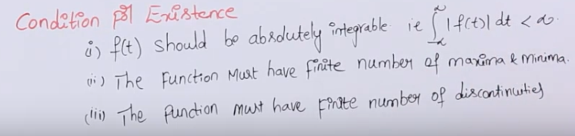
Fourier transformations
Both Fourier series and Fourier transformation are mathematical tools for representing signal in frequency domain
Fourier series is mainly used for periodic signal and Fourier transform is used for aperiodic signal
The Fourier Transform decomposes a waveform - basically any real world waveform, into sinusoids.

Slide 7
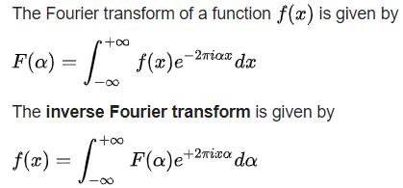
Fourier transform can exist for
Energy signal
Power signal
Impulse related signal

Slide 8
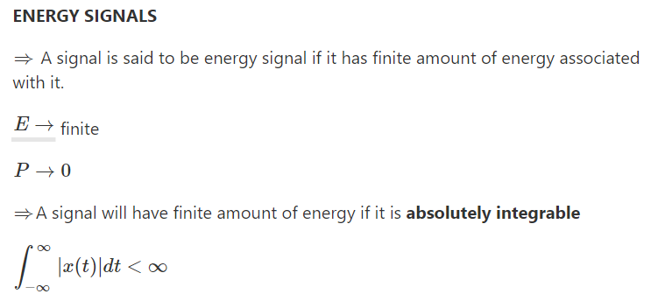

Slide 9
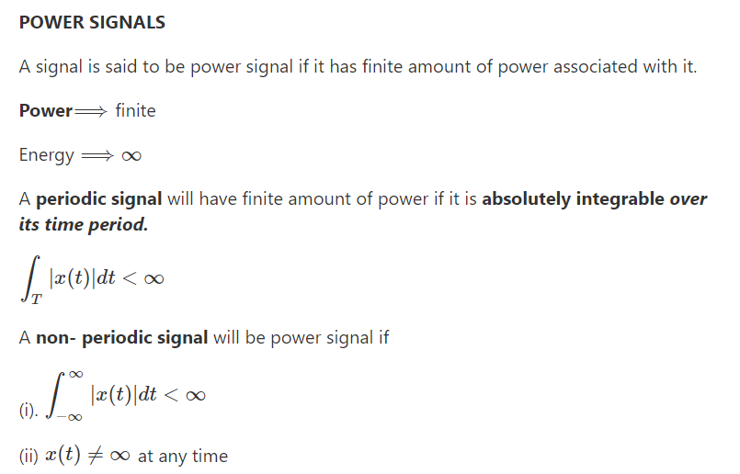

Slide 10
What are the differences between a power signal and an energy signal?
A firecracker is the best example of an energy signal. Suppose you light a firecracker.A firecracker possesses a finite amount of energy, and combustion stops once the chemical energy stored in it runs out. Thus if we attempt to compute the power delivered by the firecracker over a very long (read infinite) period of time it will be zero. This is because power is energy divided by time and since the numerator (energy) is finite and the denominator (time) tends to infinity, the power of an energy signal is zero.
Our sun is a good approximation of a power signal. This is because it delivers near constant power for very long periods of time (billions of years). In other words the energy of a power signal is infinite,because power multiplied by time is energy and since power is constant and time tends to infinity, the energy of a power signal tends to infinity. Remember in our example the sun is only an approximation to the ideal case because the sun does not contain infinite energy and will run out of energy someday. However, for our purposes it can be approximated as a constant power source. An ideal power signal is impossible to find in nature as it must contain infinite energy.

Slide 11
Please refer class notes for properties of Fourier transformation.

Slide 12
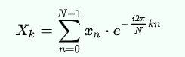
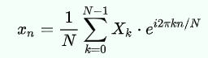
Discrete Fourier transform
Since we are dealing with images, and in fact digital images, so for digital images we will be working on discrete fourier transform
The DFT is the sampled Fourier Transform and therefore does not contain all frequencies forming an image, but only a set of samples which is large enough to fully describe the spatial domain image. The number of frequencies corresponds to the number of pixels in the spatial domain image, i.e. the image in the spatial and Fourier domain are of the same size.
Discrete Fourier transform transforms a sequence of N complex numbers into another sequence of complex numbers,which is defined by
The inverse transform is given by:

Slide 13
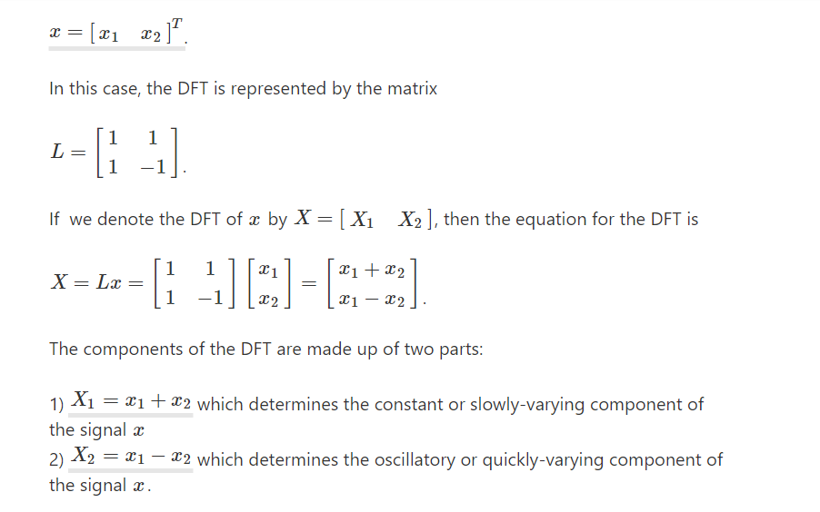
The DFT is a mathematical technique to decompose a signal into sinusoidal components of various frequencies ranging from 0 frequency (i.e., constant) up to the maximum frequency (i.e., just below the half the sampling rate). To gain some intuition, it might be helpful to consider a simple case, that of a signal with just two components:

Slide 14
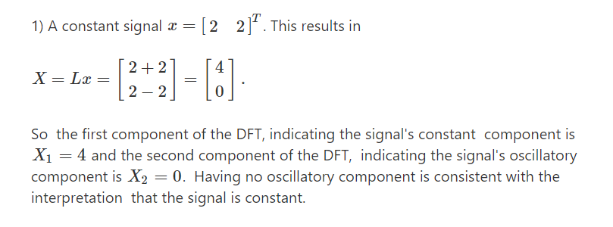

Slide 15
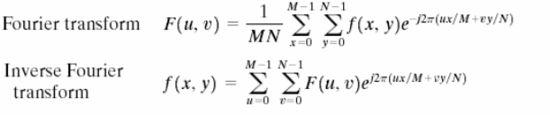
The spatial frequency directly relates with the brightness of the image. The magnitude of the sinusoid directly relates with the contrast. Contrast is the difference between maximum and minimum pixel intensity. Phase contains the color information.
The formula for 2 dimensional discrete Fourier transform is given below.

Slide 16
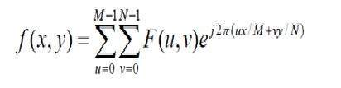
The discrete Fourier transform is actually the sampled Fourier transform, so it contains some samples that denotes an image. In the above formula f(x,y) denotes the image, and F(u,v) denotes the discrete Fourier transform. The formula for 2 dimensional inverse discrete Fourier transform is given below.
The inverse discrete Fourier transform converts the Fourier transform back to the image

Slide 17
The Discrete Fourier Transform (DFT) is a specific form of Fourier analysis to convert one function (often in the time or spatial domain) into another (frequency domain). DFT is widely employed in signal processing and related fields to analyze frequencies contained in a sample signal, to solve partial differential equations, and to preform other operations such as convolutions.
Fast Fourier Transform (FFT) is an efficient implementation of DFT and is used, apart from other fields, in digital image processing. Fast Fourier Transform is applied to convert an image from the image (spatial) domain to the frequency domain. Applying filters to images in frequency domain is computationally faster than to do the same in the image domain.

Slide 18
Refer class notes for the numerical of FT and DFT.

Slide 19
Some Basic Filter in Frequency Domain
A filter supress some frequencies in the transform while leaving other unchanged.
There are two types of filter
Low pass filter (Smoothing filter)
Low frequency in Fourier transform are responsible for general grey level appearance of an image over smooth area.
A filter which attenuates high frequency while passing only low frequency is known as low pass filter.
Such filter always appears smoother.
High pass filter (Sharpening filter)
High frequency in Fourier transform are responsible for details such as edge and noise.
A filter which attenuates low frequencies while passing high frequency is known as high pass filter.
Such filter always appears sharper.

Slide 20
Smoothing Frequency Domain Filters
Edge and other sharp transition such as noise in the gray level of an image contribute significantly to high frequency content of its Fourier transform.
Thus, smoothing may be achieved in the frequency domain by attenuating a specified range of high frequency components in the transform of a given image.
Let us reproduce the expression representing the basic model for filtering as
Where, G(u,v) is the Fourier Transform of the image to be smoothed and H(u,v) is transfer function which yields F(u,v) by attenuating the high frequency components of G(u,v).

Slide 21
There are three types of low pass filter
i. Ideal LPF
ii. Butterworth Filter
iii. Gaussian LPF

Slide 22
Ideal Low pass filter
The simplest low pass filter may be a filter which cuts off all high frequency components of the Fourier transform that are at a distance greater than a specified distance Do from the origin of the transform Such type of filter is known as 2D ideal low pass filter.
The centre coefficient F (M/2, N/2) correlates to lower frequency of the original image. As we move away from it
i.e. centre, in any direction the Fourier coefficients correlate to higher and higher frequencies.
Low pass filters — only pass the low frequencies, drop the high ones
It has the following transfer function.

Slide 23
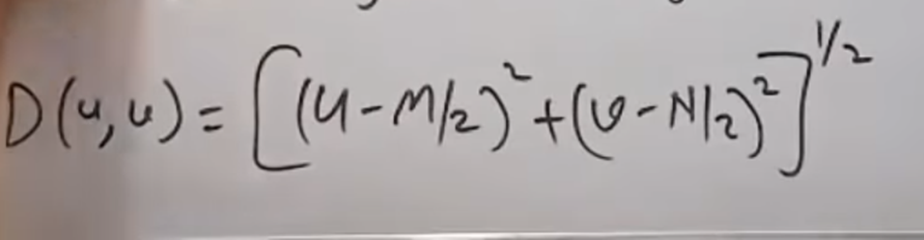
H(u,v)=1, D(u,v)<=D0
=0, D(u,v)>D0
i.e. D(u, v) is the distance from the point (u, v) to the origin of frequency. D0 is specified non negative quantity i.e. Cut-off distance.

Slide 24
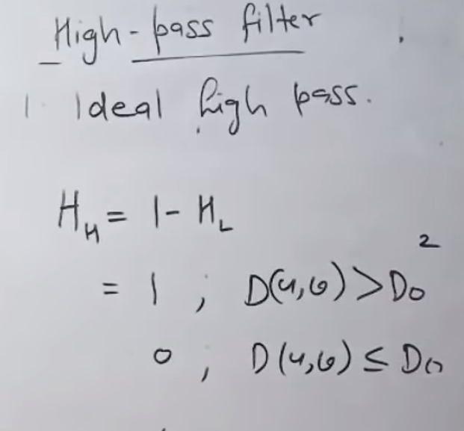

Slide 25
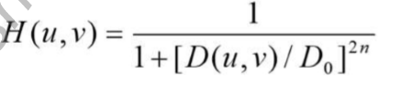
Butterworth LPF
The transfer function of a Butterworth lowpass filter of order n with cut-off frequency at distance Do from the origin is defined as:

Slide 26
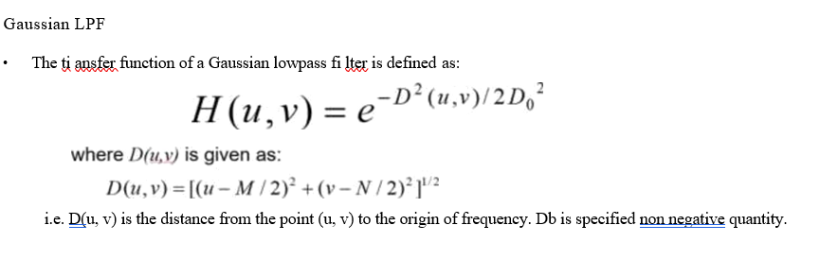

Slide 27
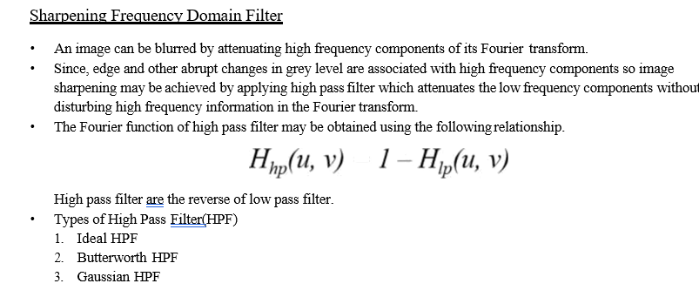

Slide 28
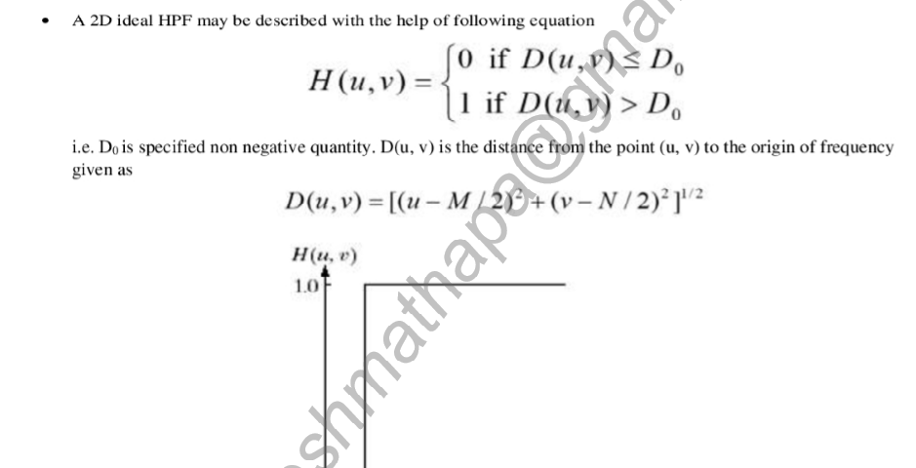

Slide 29
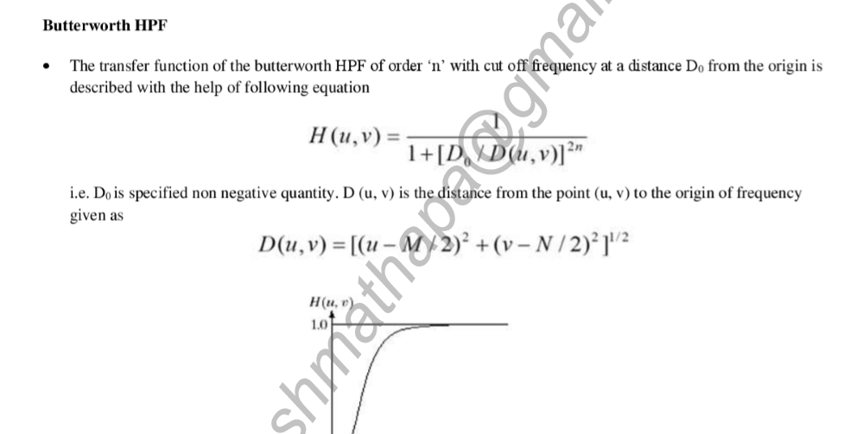

Slide 30
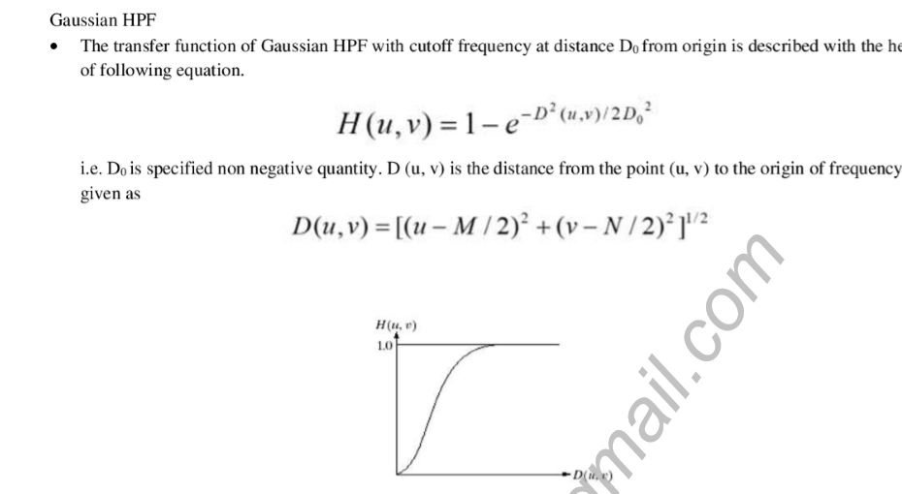

Slide 31
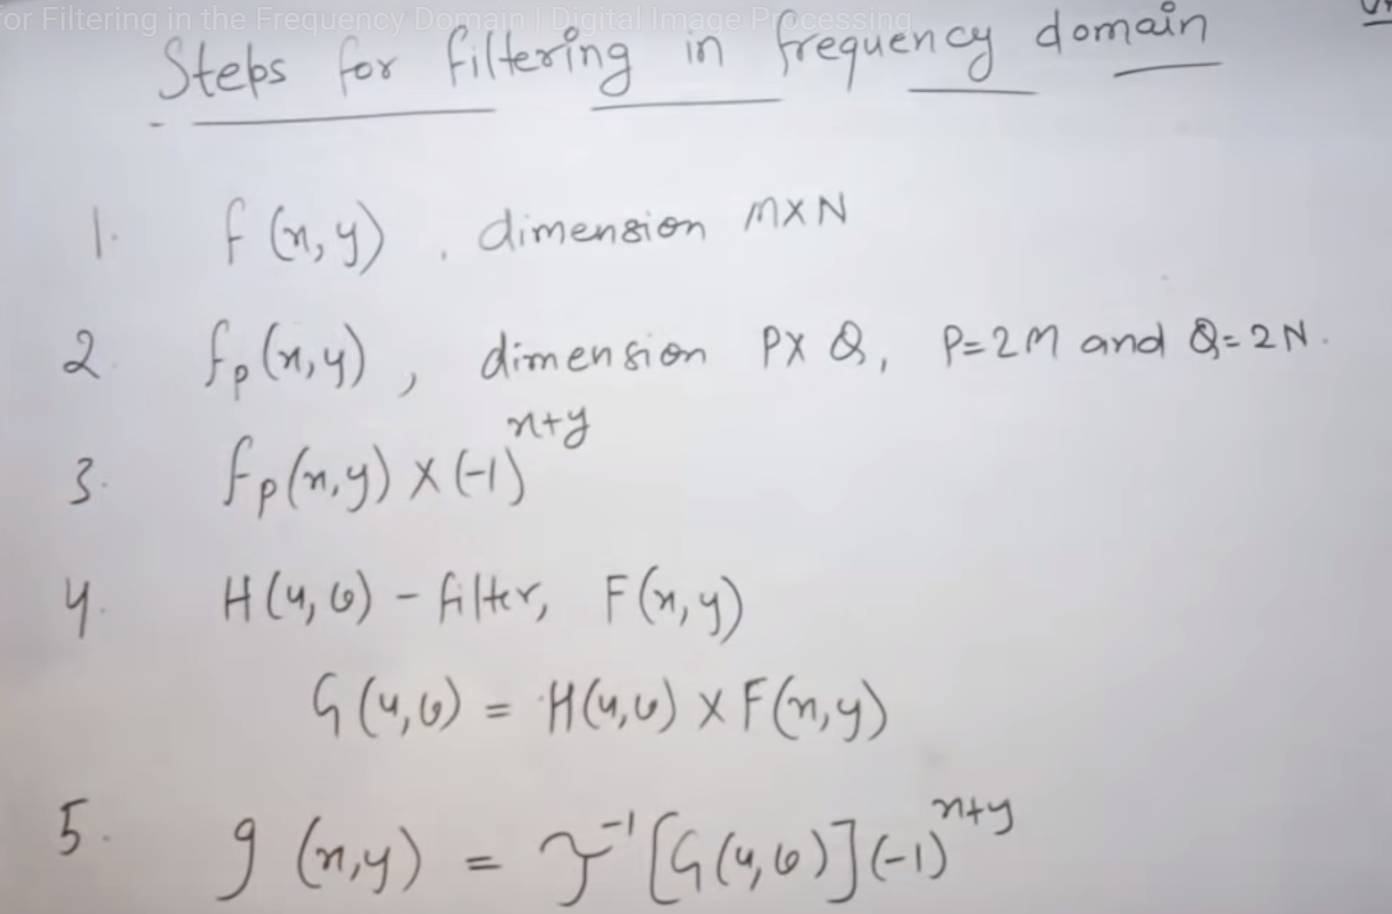

Slide 32
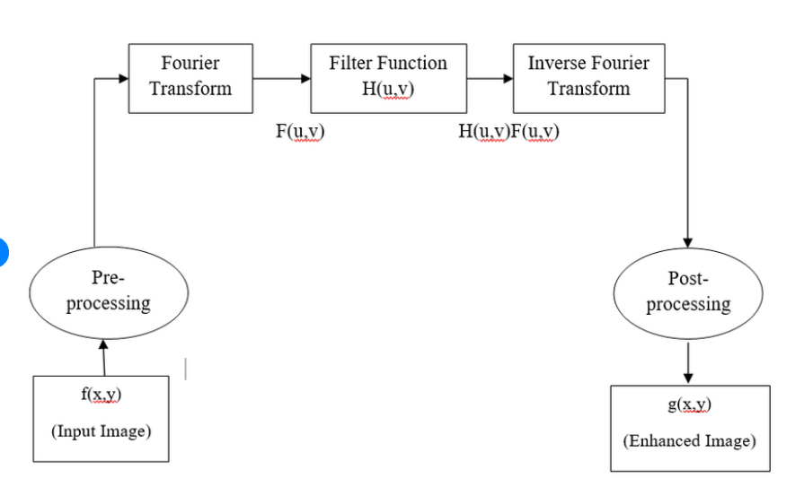

Slide 33
Hadamard Transform
The elements of a basic vectors of a Hadamard transform takes only the binary values i.e. +1 and -1 in its kernel matrix.
Hadamard transform can be implemented in order of O[NlogN] addition and subtraction.

Slide 34
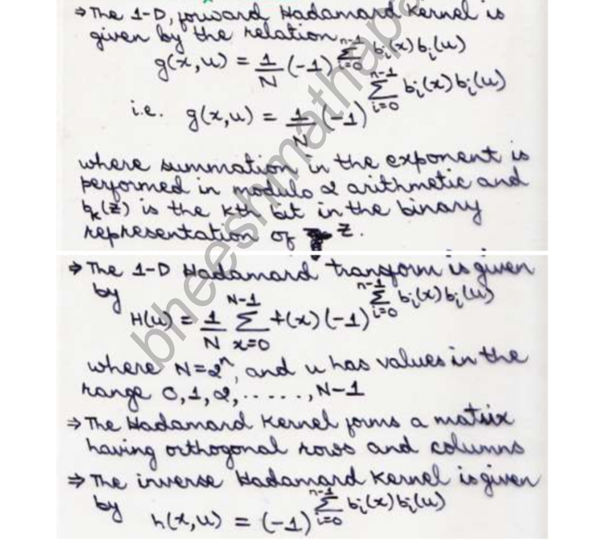

Slide 35
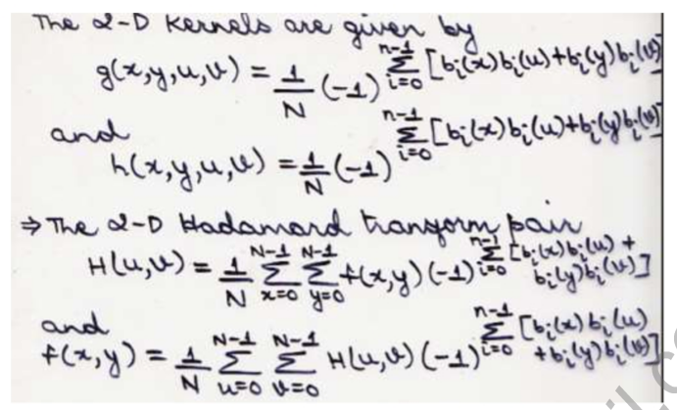

Slide 36
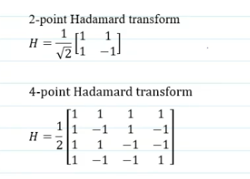
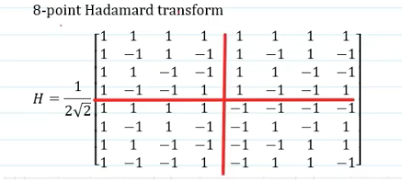

Slide 37
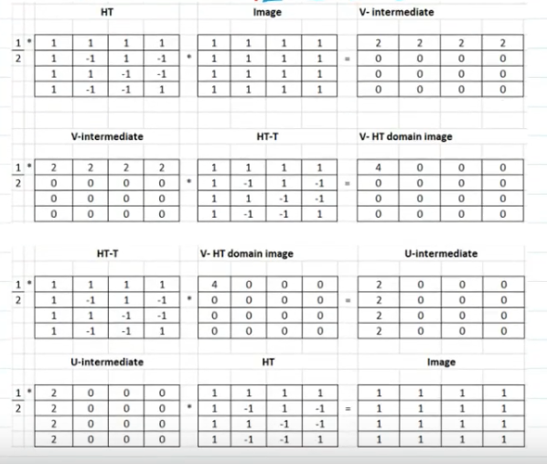

Slide 38
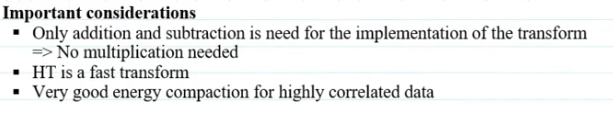

Slide 39
Haar transform
The Haar transform is one of the oldest transform functions, proposed in 1910 by the Hungarian mathematician Alfréd Haar. It is found effective in applications such as signal and image compression in electrical and computer engineering as it provides a simple and computationally efficient approach for analysing the local aspects of a signal.

Slide 40
Property
The Haar transform has the following properties
1. No need for multiplications. It requires only additions and there are many elements with zero value in the Haar matrix, so the computation time is short. It is faster than Walsh transform, whose matrix is composed of +1 and −1.
2. Input and output length are the same. However, the length should be a power of 2, i.e. .
3. It can be used to analyse the localized feature of signals. Due to the orthogonal property of the Haar function, the frequency components of input signal can be analyzed.
Application
Modern cameras are capable of producing images with resolutions in the range of tens of megapixels. These images need to be compressed before storage and transfer. The Haar transform can be used for image compression. The basic idea is to transfer the image into a matrix in which each element of the matrix represents a pixel in the image. For example, a 256×256 matrix is saved for a 256×256 image. JPEG image compression involves cutting the original image into 8×8 sub-images. Each sub-image is an 8×8 matrix.

Slide 41
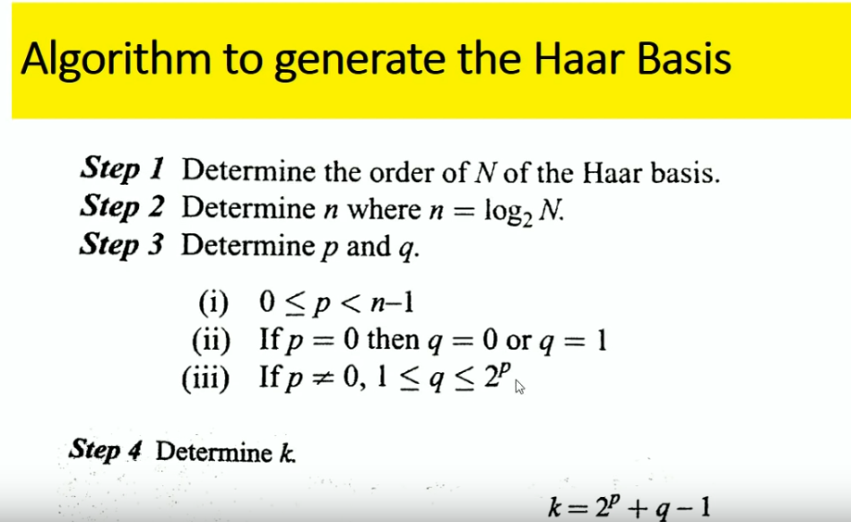

Slide 42
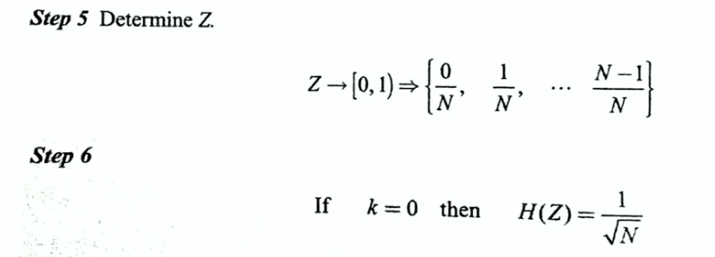

Slide 43
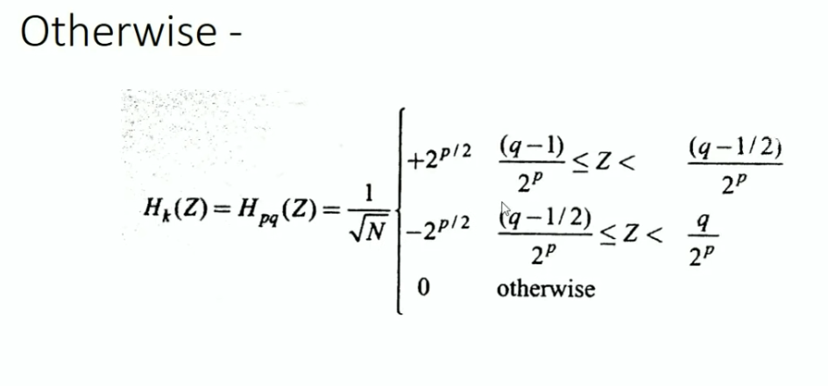

Slide 44
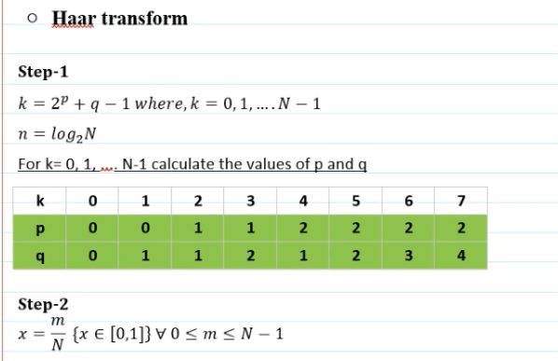

Slide 45
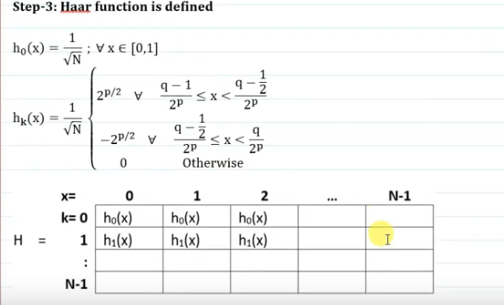

Slide 46
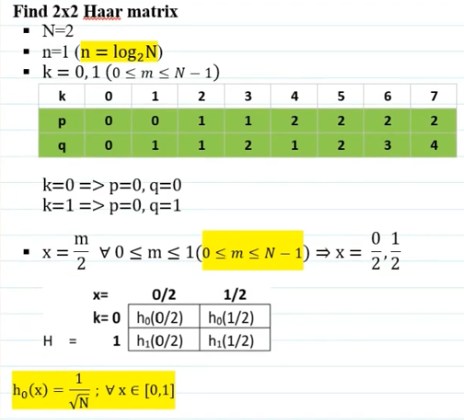

Slide 47
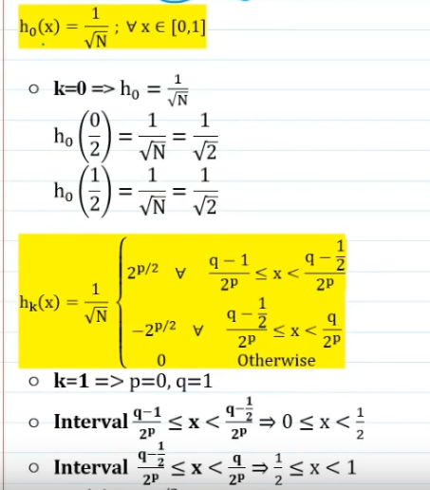
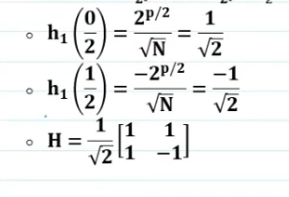

Slide 48
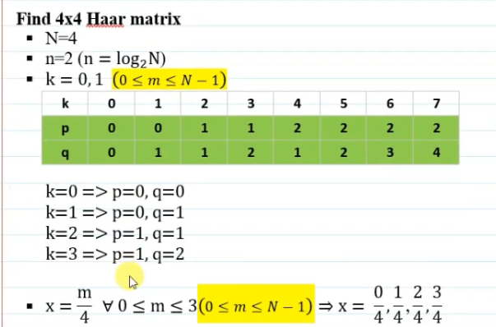

Slide 49
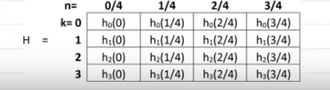

Slide 50
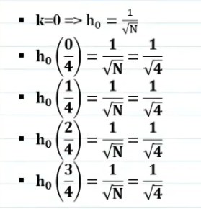
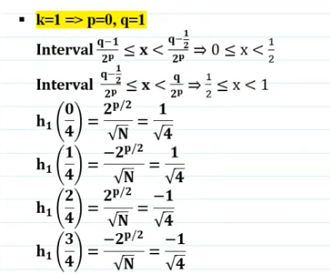

Slide 51
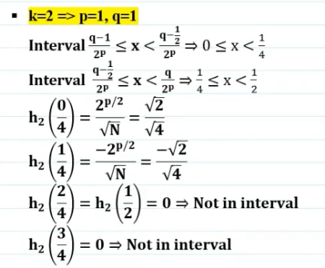
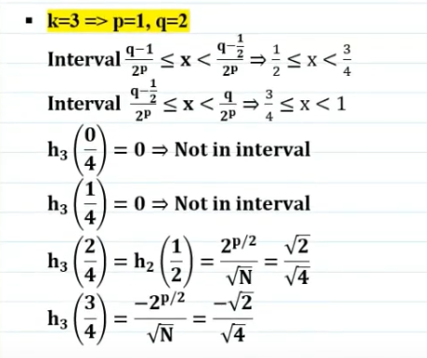

Slide 52
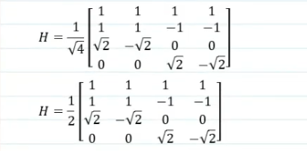

Slide 53
Discrete cosine transform (DCT)
A discrete cosine transform (DCT) expresses a finite sequence of data points in terms of a sum of cosine functions oscillating at different frequencies. The DCT, first proposed by Nasir Ahmed in 1972, is the most widely used transformation technique in signal processing and data compression. It is used in most digital media, including digital images (such as JPEG and HEIF, where small high-frequency components can be discarded), digital video (such as MPEG, H.26x and Vorbis), digital audio (such as Dolby Digital, MP3 and AAC), digital television (such as SDTV, HDTV and VOD), digital radio (such as AAC+ and DAB+), and speech coding (such as AAC-LD, Siren and Opus). DCTs are also important to numerous other applications in science and engineering, such as digital signal processing, communications devices, reducing network bandwidth usage, and spectral methods for the numerical solution of partial differential equations.

Slide 54
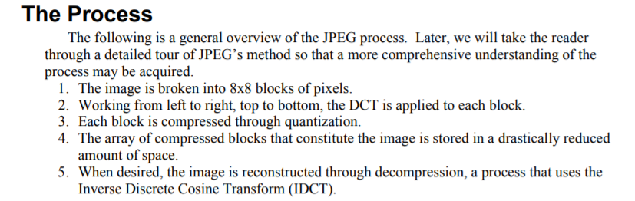

Slide 55
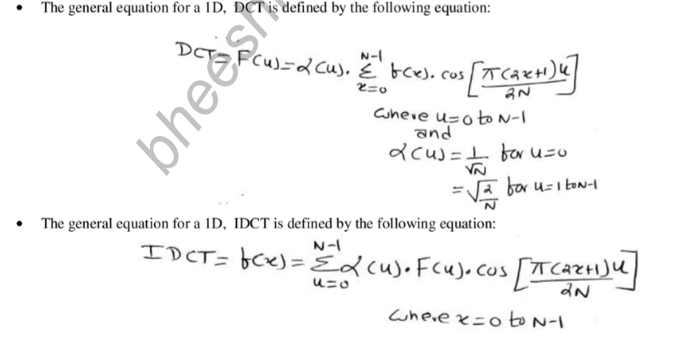

Slide 56
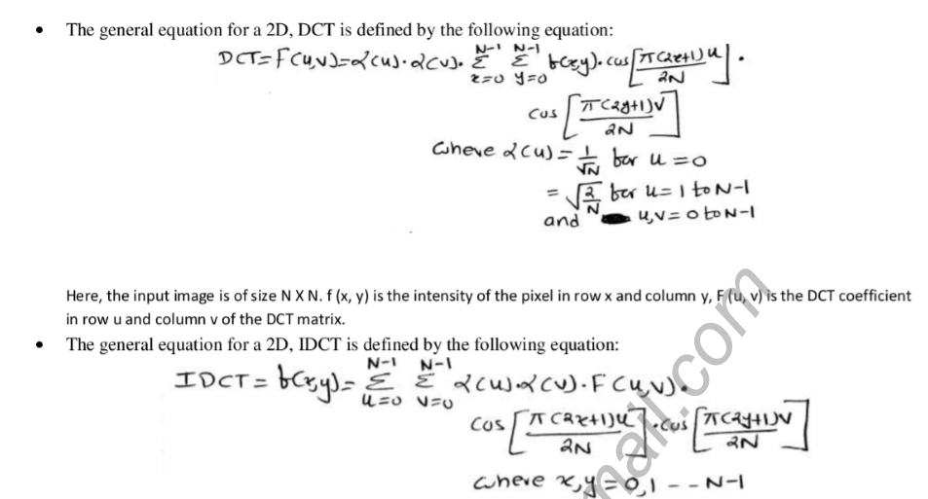

Slide 57
